Slide 5
Learning rate is very small…

Slide 6
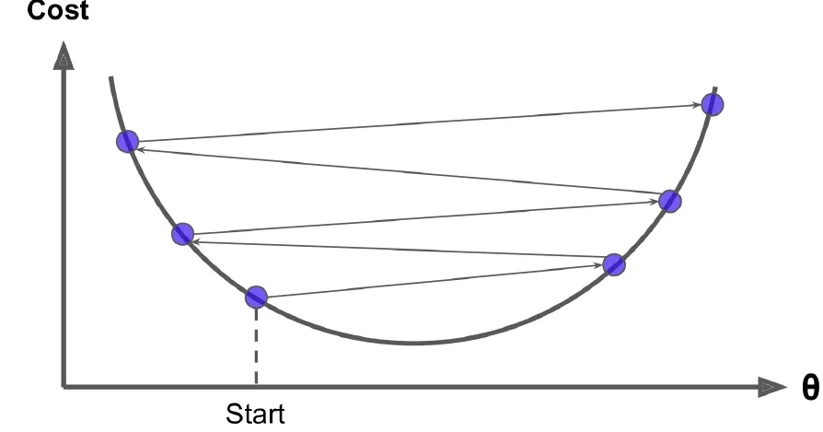
Learning rate is too large…

Slide 7
Can Gradient descent be used to find
optimal parameters for any function?
Only for the convex objective function
Gradient Descent (or any other optimization algorithm) is guaranteed to find the global minimum (if the learning rate is not too large and you wait long enough).

Slide 10
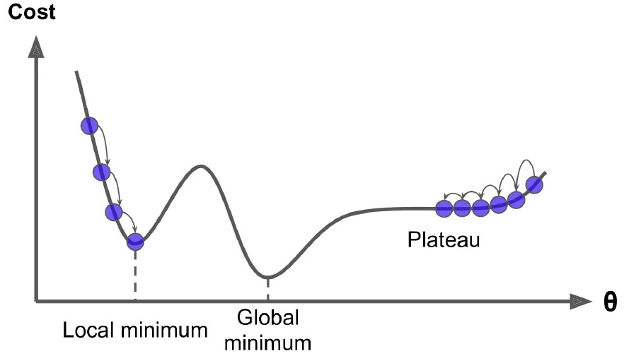

Slide 12
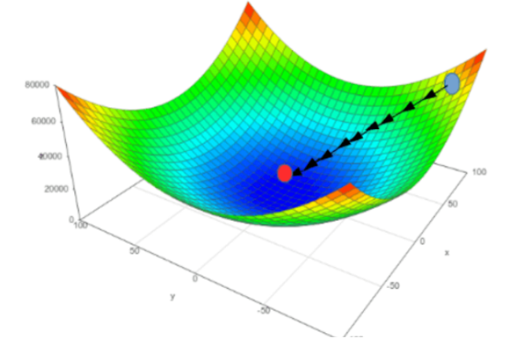

Slide 13
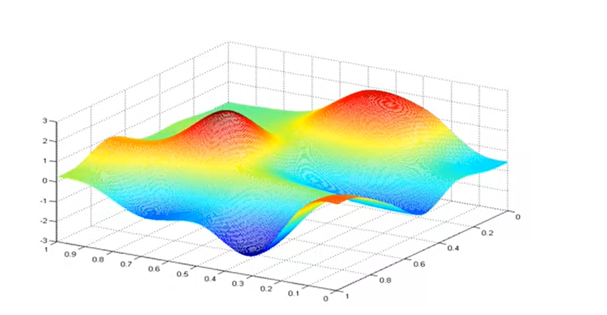

Slide 15
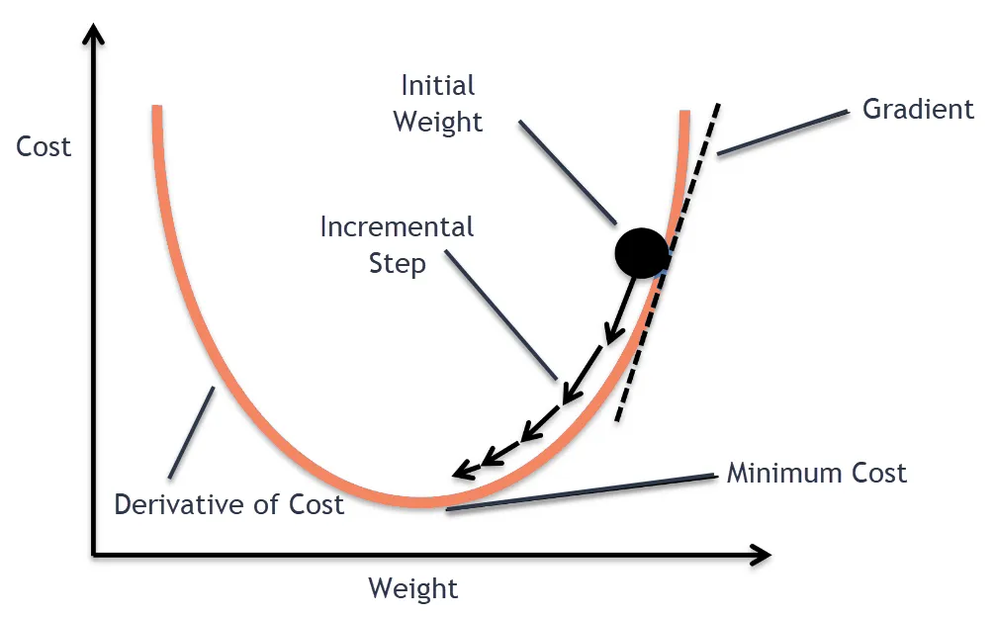
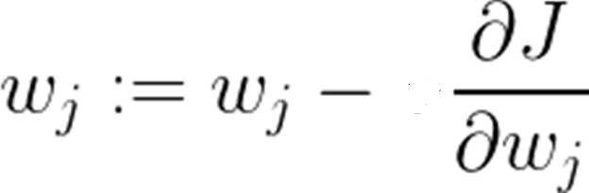
GD
η

Slide 17
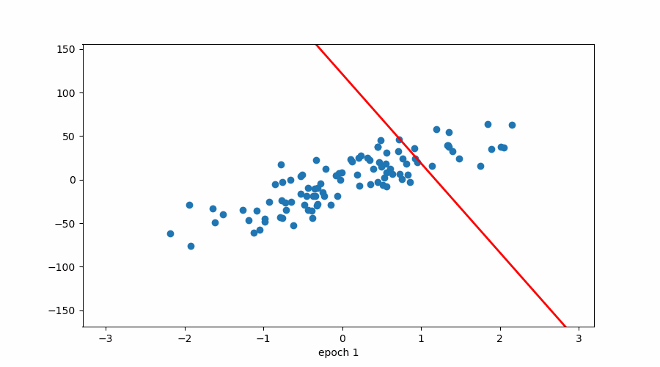
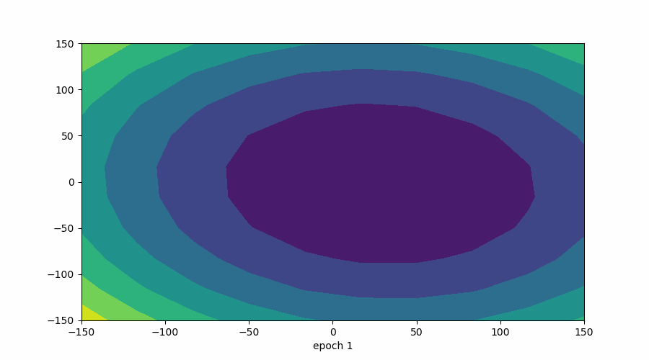
Batch GD

Slide 18
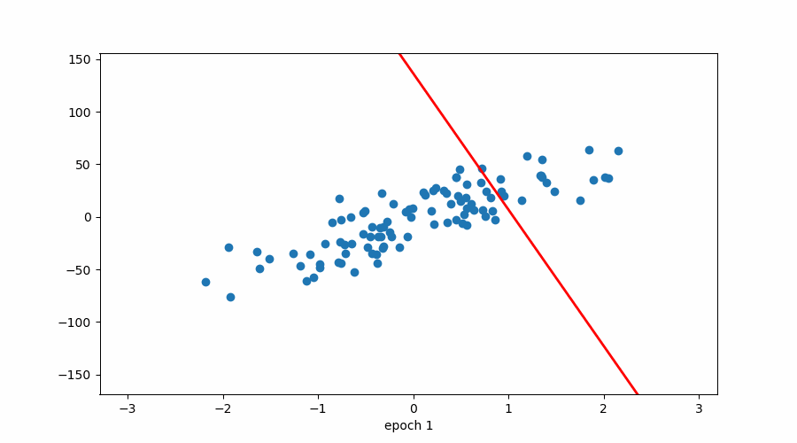
SGD

Slide 20
BGD
SGD
MBGD

